Slide 1
Looking Forward TO FHIR
HINZ November 2013
Grahame Grieve

Slide 2
Outline
What is FHIR?
What’s a resource?
The parts of a resource
How to use resources
What’s the big deal?
Why do we need something new?
Why such a big change?
What does this mean for existing implementers? (PCEHR)

Slide 3
FHIR – the name
FHIR = Fast Health Interoperability Resources
An unused acronym
FHIR is pronounced “Fire” (not “fur”)
It’s a great generator of jokes
“putting a fire under HL7”
Other ideas for what the acronym stands for
I didn’t pick the name

Slide 4
What’s a Resource
A source of specific information
Defined Content and behaviour
Referenced with a fixed identifier
Communicate via a standardised interface (HTTP)
Inter-changeable representations
“End-point” (Server) manages content
http://en.wikipedia.org/wiki/Representational_state_transfer#Central_principle

Slide 5
FHIR and Resources
FHIR defines resources for healthcare
Basic requirements
Stable identification across life-cycle
Known, well described, stable content
Understood mapping from business work-flows to resource existence, content, and state
Basic rules must be respected
Allows content to move in and out of pure HTTP/server environment

Slide 6
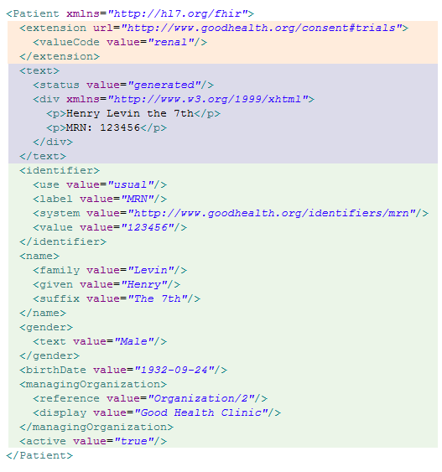
4 Aspects of a Resource
Metadata
Extensions
HTML Presentation
Structured Data

Slide 7
Identification / Metadata
Item | Usage
Type | Possible Types are defined by spec – can never change
Id | Identifier that never changes – Absolute or relative URL
Version Id | Changed each time the content of the resource changes.
Last Modified Date | Can be used by a system or a human to judge the currency of the resource content
Security Labels | Apply specific connections to access control policy to particular resources

Slide 8
Structured Data
A hierarchy of named elements
Each element has
Name, definition, comments, requirements
Conditions / invariants
Type, cardinality
Sub-elements, terminology bindings
Element names are “business” focused – natural names in the context of use

Slide 9
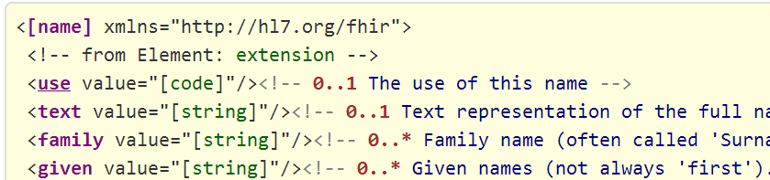
Simple XML Presentation
Name – the name of the element – hyperlink to formal definition
Cardinality – appearance rules (min = 0 or 1, max = 1 or *)
Type – hyperlink to type definition
Short definition
Copy into XML editor and fill out content (or use schema driven editor)

Slide 10
Structured Data
Each element may have mappings to the other formats or formalisms
HL7 defined elements will always have mappings to the RIM.
Other common mappings:
HL7 v2, V3 domain models, consolidated CDA
openEHR archetypes
Snomed-CT, LOINC, etc
DOLCE, OBO, etc

Slide 11
Structured Data Mappings
FHIR does not define a modelling/definitional methodology
The mappings are the source of rigour & consistency
Mappings provided in computable form
W3C has RDF project
Mappings are not required for implementation

Slide 12
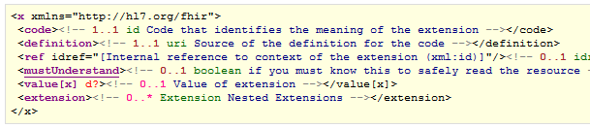
Extensions
Every Resource has an extensions section
Extensions have:
Definition URL – get the definition from here
Internal reference into the structured data
Value (or more extensions)

Slide 13
Extensions
Extension schema is fixed – everybody can read/write all extensions allowed
Making Extensions useful allows for simpler definitions
Anyone can create and define extensions
Must publish formal definitions in implementation scope
must-understand allows for extensions to quality or negate pre-defined elements

Slide 14
HTML Presentation
Every resource includes an html presentation
Fall-back for human use (i.e. when system can’t understand contents of resource)
Idea copied from CDA – but much more control than CDA
Content is XHTML (no forms, active content, web links etc)
Images can be in-lined in resources

Slide 15
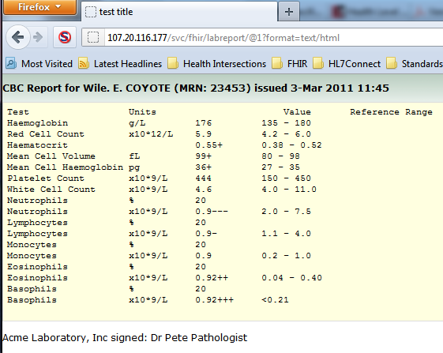
Example Presentation
http://107.20.116.177/svc/fhir/labreport/@1?format=text/html

Slide 16
FHIR Implementation
Resources can be used:
In an HTTP REST fashion (servers/clients)
Use with OAuth for global social media EHR
In a classic HL7 v2 messaging fashion
Like a CDA document (a bundle of resources)
In other services as desired
HL7 / IHE / national programs define services

Slide 17
Atom Feeds
Many cases need to bundle resources in a list
A message is a list of resources with a message header
A document is a list of resources with a document header
A search/update list returns a list of resources
Implement these as Atom feeds
Re-use existing web pub/sub frameworks such as google reader (e.g. subscribe to your own EHR)

Slide 18
FHIR Implementation
Representations of resource definitions:
W3 Schema, relax NG schema, schematron
eCore, RDF definitions, ADL
UML
Representations of resource instances:
XML, JSON, RDF
Java, C#, Delphi, Objective C implementations
Tools
design, validation, profiling
Registries / Respositories
Note: some of these are still under development

Slide 19
FHIR License
Most initial implementations will be outside the existing community (mobile/cloud apps) – i.e. non-members
Plain English license:
FHIR is © HL7. The right to maintain FHIR remains vested in HL7
You can redistribute FHIR or create derivative specifications or implementation related products and services
Derivative Specifications cannot redefine what conformance to FHIR means
You can't claim that HL7 or any of it's members endorses your derived [thing] because it uses content from this specification
Neither HL7 nor any of the contributors to this specification accept any liability for your use of FHIR

Slide 20
FHIR Implementation
FHIR is for implementers
Resource designers have to produce examples instances – lots of them
Document resources for implementers
Hold connectathons to test infrastructure and resources
First connectathon: Sept 8 (Baltimore)
FHIR is about making it work

Slide 21
FHIR for v2 Implementers
Start with a v2 message… and imagine….
Give each segment a URL to identify it
can put segments on a server and get/update them independently
Use XML to represent the segment – using field names
Add an html representation
Put a little z-section at the end (extension definitions published!)
Messages = segments in a row with message header
Call the segments “resources”
Redefine the list of segments and their contexts

Slide 22
Why do we need something new?
FHIR is a huge change from past practice
Almost a clean slate
Re-implementation is required
Business Sponsors ask “do you have to make this much change? Why not do something less?”
i.e. why not just “fix” v3(?)?

Slide 23
Why do we need something new?
Fundamental problem:
How do you make change compelling enough to justify the cost of change?
Small change = small cost, small benefit
Big change = big cost, big benefit
Backwards compatibility generates buy-in, but creates lock-in
change will be destructive

Slide 24
Why do we need something new?
v2 Messaging
Venerable and well understood
Inherent limitations (fixed definitions & syntax, transactional nature) not resolvable
Any important change will abandon backwards compatibility & all existing implementation stacks
Small change will never justify the cost

Slide 25
Why do we need something new?
CDA
Focus of much current adoption
Implementation is hard work (harder than it should be)
It’s scope limitations are baked into it’s success
No sweet spot where change is justified
V3
Backwards compatibility prevents change
E.g. ISO 21090 very unlikely to be adopted in practice

Slide 26
What standard should you use…
If you are building a new iOS healthcare app (and thousands are)?
If you want to provide a cloud based health app that integrates with social networks?
If you wants a simple to use exchange standard that integrates with existing architecture?
If you want to provide a simple to use standards based API to cloud based health integration services?
If you want to implement a national EHR?
What does HL7 have to offer?

Slide 27
For existing implementers
FHIR is a d

Slide 28
What’s the big deal?
Why do we need something new?
What such a big change?
What does this mean for existing programs? (PCEHR)

